Slide 1
Chap#3
Managing Software

Slide 2
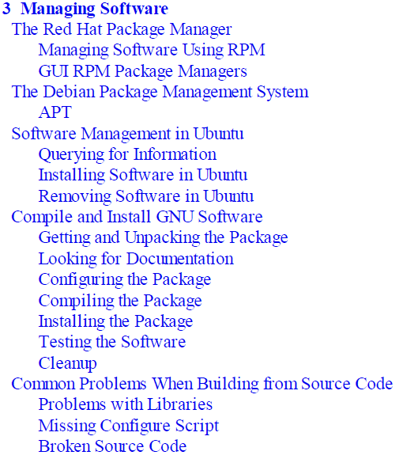
Content

Slide 3
Introduction
System administrators deal with software and application management in various ways.
This approach has its benefits as well as its drawbacks. One of the benefits is that the system tends to be more stable and behave in a predictable manner. Because the core system software hasn’t changed drastically, it should pretty much behave the same way it did yesterday. The drawback to this approach is that the system will lose the benefits of bug fixes and security fixes that are available for the various installed applications if these fixes are not applied.
system administrators take the exact opposite approach: They like to install the latest and greatest software available. This approach also has its benefits and drawbacks. One of its benefits is that the system tends to stay current as security flaws in applications are discovered and fixed. The obvious drawback is that some of the newer software might not have had time to benefit from the maturing process and hence might behave in slightly unpredictable ways.
From a purely technical perspective, software management under the mainstream Linux distros is done via the following:
RPM The Red Hat Package Manager is the common method for Red Hat–like systems such as Fedora, Red Hat Enterprise Linux (RHEL), and CentOS.
DPMS The Debian Package Management System is the basis for software management on Debian-based systems, such as Ubuntu, Kubuntu, and Debian.
Source code The more traditional approach for the Linux die-hards and purists involves compiling and installing the software by hand using the standard GNU compilation method or the specific software directives.

Slide 4
The Red Hat Package Manager
Following are the primary functions of the RPM:
Querying, verifying, updating, installing, and uninstalling software
Maintaining a database that stores various items of information about the packages
Packaging other software into an RPM form
Pg 75 (commands)
Notes:
Verbose: more detailed information

Slide 5
Managing Software Using RPM
Use rpm command to list all packages that are currently installed on your system.
Use bash with rpm to know the version number and package name.
Commands from book
summary of the various error codes page 85
APT is a highly regarded and sophisticated toolset. It is an example of a wrapper tool that interacts directly with dpkg.

Slide 6
Software Management in Ubuntu
Page 89 for Commands.

